Slide 1
Shiny App Validation
in Regulatory Submissions
Community Meeting
12:00 EST
25th Feb, 2025

Slide 2

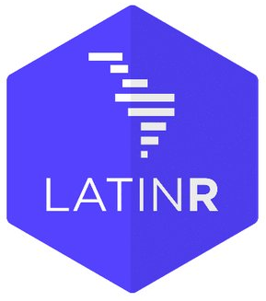
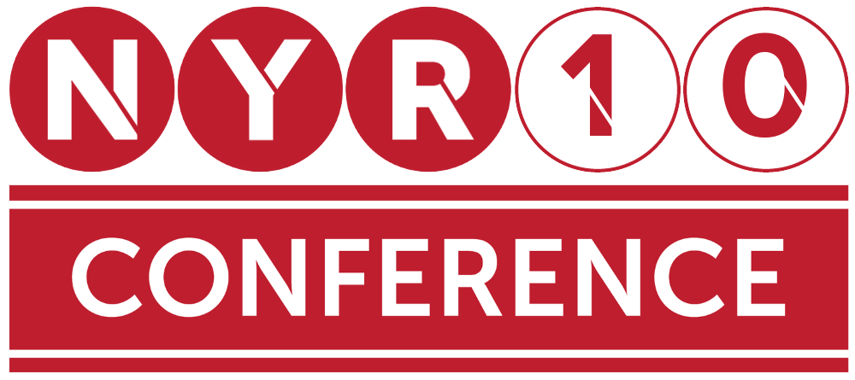


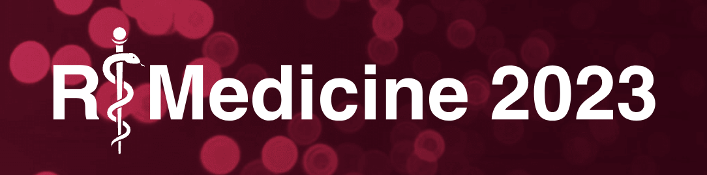


R Consortium Pragmatic Support with Global Reach
R Consortium Community Grants and Sponsorships Over USD $1.4 Million
Organize large scale collaborative projects
R Validation Hub
R-Ladies
R Submissions Working Group
Co-host multidisciplinary data science forums
Stanford Data Institute
Direct support for key R events
useR!, New York R, R/Medicine, R/Pharma, more
Direct support for R User Groups

Slide 3

Join the R Consortium! The R Validation Hub is a Working Group under the R Consortium
Enhance the R ecosystem
Help ensure the future of R
Collaborate with your peers across industry
Provide leadership in the R Community
Protect your investment in R
Support open source
Notes:
The R Consortium enables companies in competitive industries to act collectively when approaching government agencies: e.g. the R Validation Hub project driven by the pharmaceutical industry.
The R Consortium is positioned to cooperate with other data science organizations to work for the common good: e.g. the COVID-19 Data Forum
R Consortium technical working groups provide seed funding and a focus for large scale cooperation for exploratory projects.
The R Consortium promotes and enables diversity in practical and concrete ways that are highly influential: e.g. R-Ladies and the Diversity & Inclusion working group.
Membership on R Consortium technical working groups provides opportunities to shape emerging technology.
The R Consortium helps companies protect their long range investment in R.

Slide 4
Our Membership
Microsoft
Oracle
Parexel
Pfizer
Posit
Procogia
Sanofi
Swiss Re
… and more!
ASA
Biogen
esri
Genentech
Google
GSK
Janssen
Johnson & Johnson
Lander Analytics
Merck
Notes:
are always up to date.
I changed RStudio logo for posit logo

Slide 5

Structure of today’s community meeting
Primer on today’s topic
Polling about Shiny apps to learn more about everyone
Briefing on Shiny app pilots to FDA
Discussion

Slide 6
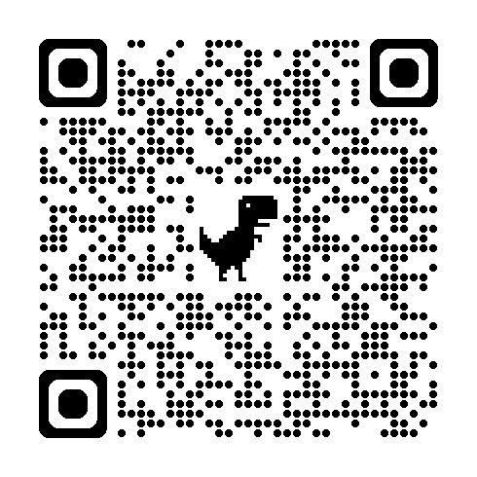
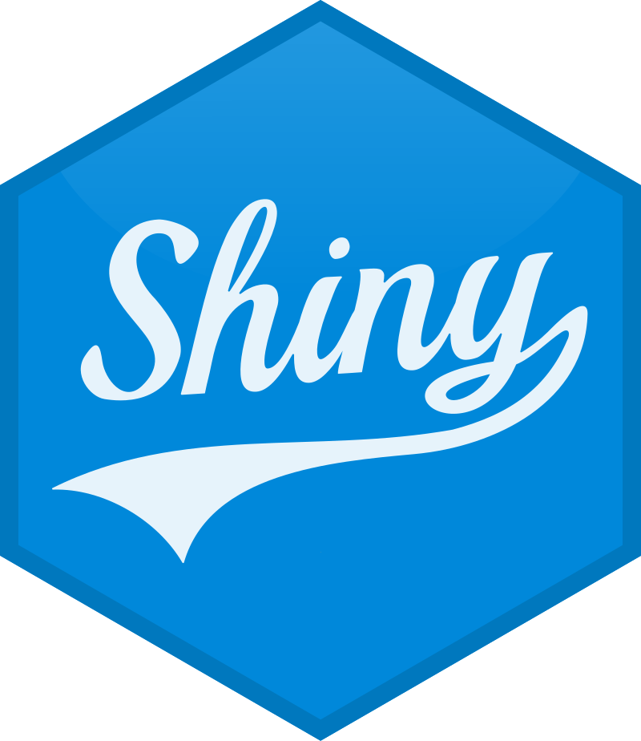
Today’s Topic
Thank you for responding to our survey we sent out last year to hear from you on what topics you wish to have spotlighted at our meetings! Our topic was born out of many requests to hear more about Shiny apps and validation related to Shiny apps.
Shiny App Validation in Regulatory Submissions
Today’s discussion can be about validation of Shiny apps in general, as well
Shiny apps are complex
Dynamic inputs/interactions and reproducibility
General expectation of no errors
User accessibility (new to apps, etc.)
…and more!
Submit to our survey here!

Slide 7

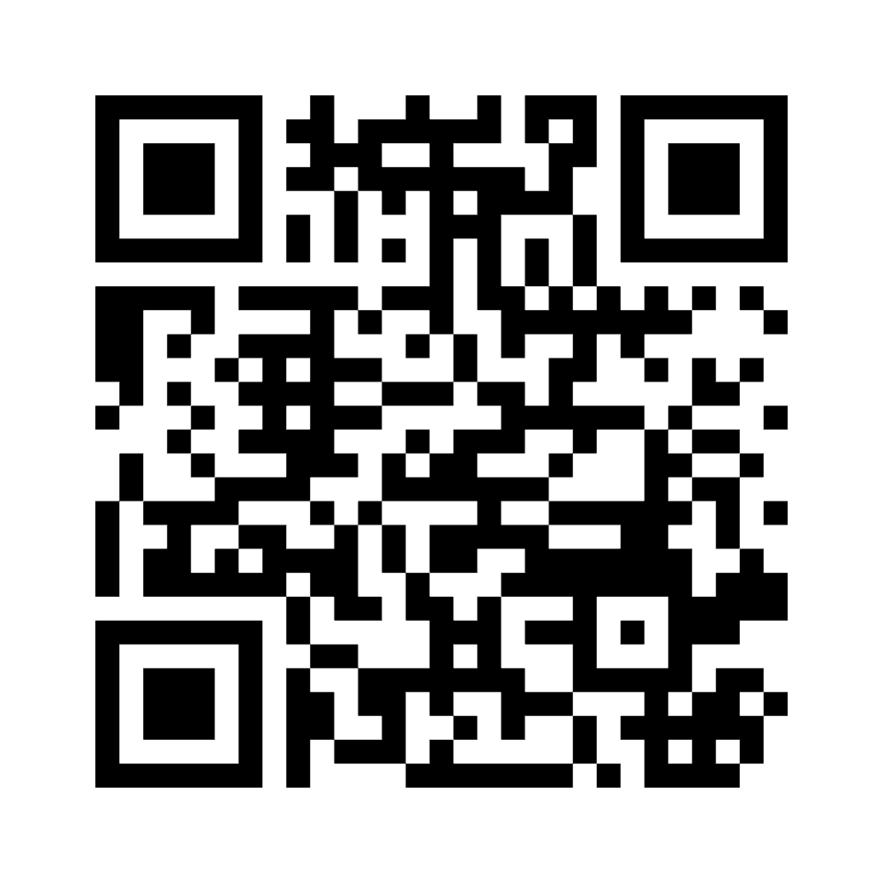
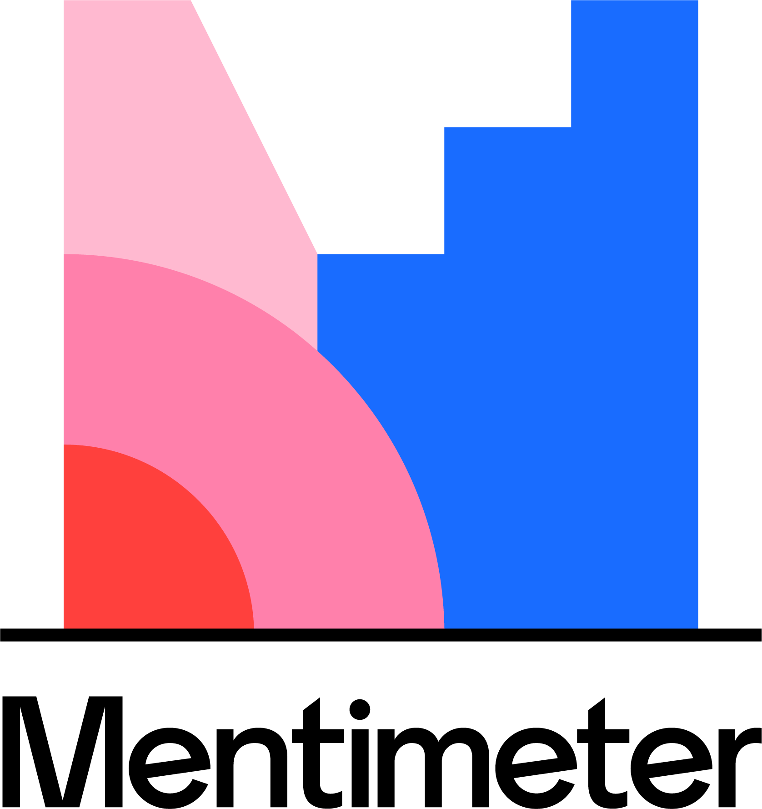
Let’s learn about each other!
Have you ever used Shiny-based apps?
What is your experience level with developing Shiny apps?
Do you or does your company typically use Shiny for data exploration, presentations, outputs for regulatory submission, or both/neither?
Join the Mentimeter to submit your responses (it’s anonymous!)

Slide 8
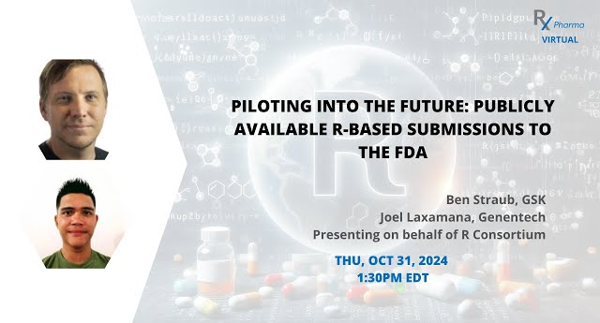
Shiny App Pilots to the FDA
R Submissions Working Group
General focus on process rather than content (ex: moving R files)
Emphasis that Shiny apps not to replace standard analysis programs
Pilot 2 (GitHub webpage for pilot)
3 tables and 1 figure, using SDTM and ADaM as source data
Finding of moving away from pkglite; package availability on CRAN
Successful review by FDA in September 2023
Pilot 4 (GitHub webpage for pilot / R Consortium post link)
Objective of exploring novel technologies for bundling Shiny apps into self-contained packages
“More to come with Containers!”
Under active review as of late November 2024

Slide 9

Discussion Questions
App validation versus package validation?
At what point are you comfortable with considering an app go be “validated?” Do you expect them to be validated to the same rigor as a package is?
Do you believe Shiny apps should be used in regulatory submissions? What are the pros and cons? Is it worth the time investment of developing an app and validating it?
What other components of Shiny apps may complicate their ability to be validated?

Slide 10
Thank you for joining!

